Slide 1
Vocabulary Building
Mythological Words, Root Words and Mnemonics as Sources

Slide 2
Mastering English Vocabulary
Latin & Greek
Retention of words from the origin language
Meaning retained/changed
Interesting nuances
Find ways to relate the word & its meaning by correlation
Easier to remember

Slide 3
Methodologies
Mythological words
Root words
Mnemonics
Prefixes & Suffixes
Word Clusters
Word Trees

Slide 4
Mythological words
Words from Greek mythology
Make for interesting reading as stories appeal more
Association with a picture possible
Helps retention and recall

Slide 5
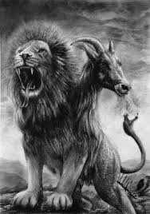
Chimera

Slide 6
Chimera
Chimerical (adj.)
Origin—from the Chimera, fire-breathing monster with a lion’s head, goat’s body, and serpent’s tail
Definition—fantastic; unreal; impossible; absurd

Slide 7
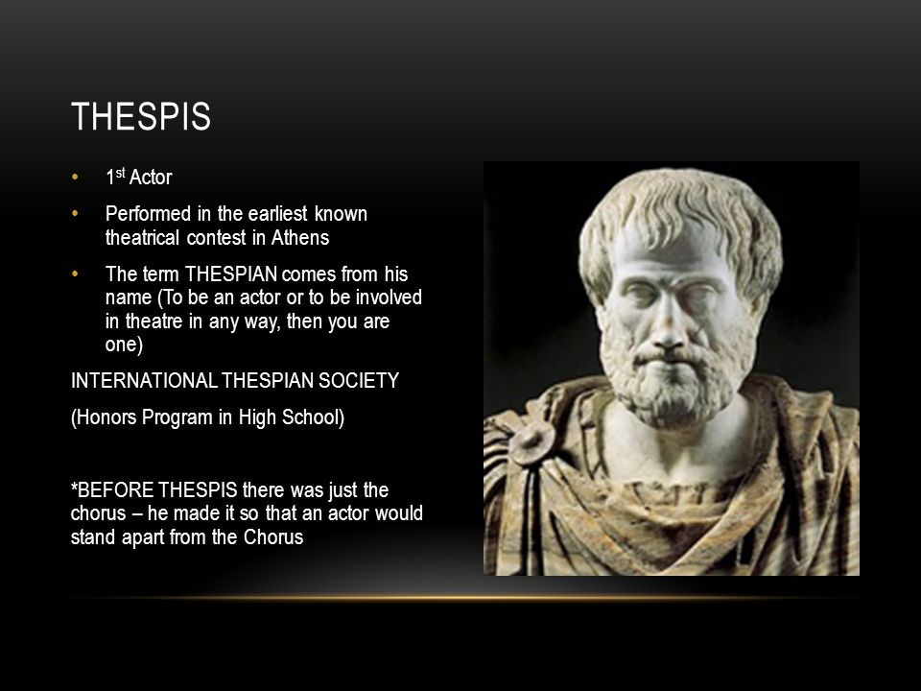
Thespian

Slide 8
Thespian
Thespian (n.)
Origin—from Thespis, father of Greek drama
Definition—pertaining to drama or acting

Slide 9
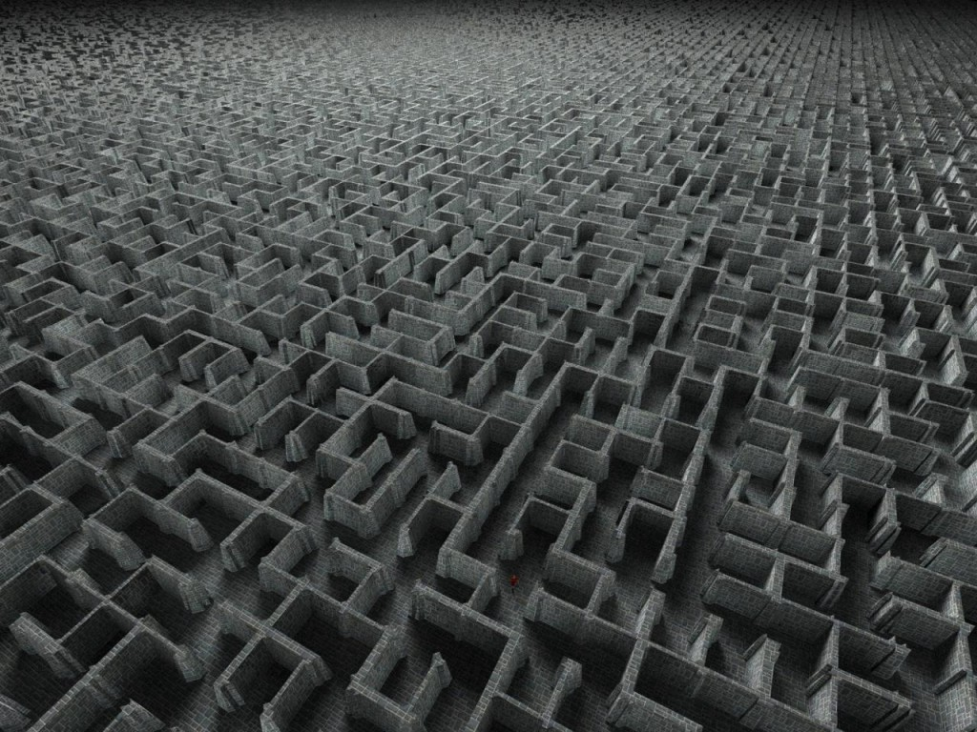
Labyrinth

Slide 10
Labyrinthine
Labyrinthine (adj.)
Origin—from Labyrinth, a fabled maze in Crete
Definition—full of confusing passageways; intricate; complicated

Slide 11
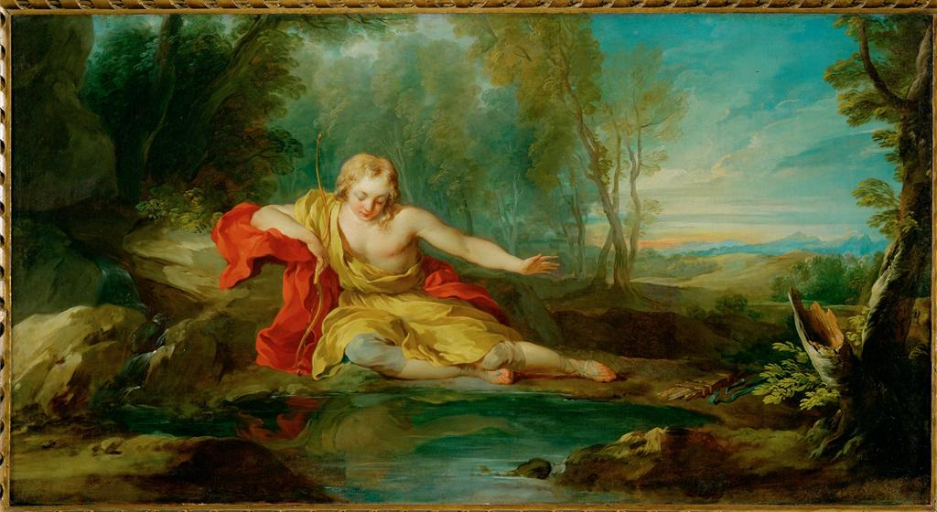
Narcissus

Slide 12
Narcissistic
Origin—from Narcissus, a young man who fell in love with his own image, which led to his death
Definition—in love with oneself; egocentric

Slide 13
Root words
Latin and Greek
Have a meaning
Given rise to several words
Possessing same or similar meaning
Can be used to learn words in cluster
Easy to learn and recall many connected words

Slide 14
Root words
Anti-against -antibacterial, antidote, antithesis
Chrome –color-monochromatic, phytochrome
Geo -earth- geography, geology, geometry
Syn -together with- synthetic, photosynthesis
Tropos –turning -heliotrope, tropical
Audi –hear -audible, audience, auditorium

Slide 15
Root Words (Cont.)
Duc -lead, make- deduce, produce, educate
Lev -to lift - levitate, elevate, leverage
Scrib, script -to write -script, proscribe, describe
Vac – empty - vacuum, vacate, evacuate
Manu – hand - manual, manicure, manipulate
Jur – law - jury, justice, justify

Slide 16
Mnemonics
Coined to remember something easily (Eg. VIBGYOR- colors of a spectrum)
Can be created and used
Should be relevant to the word’s meaning and remind the creator of the same
Will be very effective in long-term remembrance

Slide 17
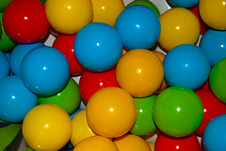
AMALGAMATE -To combine; to mix together at+mall+game= There is a game at a mall. Hence people come together...Gather for the game!

Slide 18
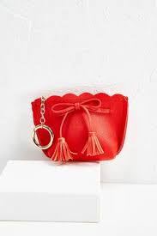
PARSIMONIOUS – Stingy/ Miserly
When you think of the word ‘parsimonious’ (similar to the word ‘purse’), think of a known person who never takes his purse out and hence does not spend money.

Slide 19
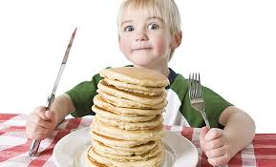
ABATE – to decrease in number or volume
Abate – I ate
When you eat something, the number or the volume remaining becomes less.

Slide 20
Have an enjoyable learning
experience!

